Slide 1


Crime Data Visualization
Using R
Prepared By:
Aditya Kumar Pandey
MTech (AI & DS), 240201001
Dept. of CSE, IIIT Bhagalpur
Submitted To:
Dr. Om Prakash Singh
Assistant Professor
Dept. of CSE, IIIT Bhagalpur
01

Slide 2
index
Case Study Introduction
Problem Statement
Dataset Information
Libraries and Packages Used
Data Preprocessing
Structure and Summary of Data
Crime Category Distribution
Top 10 Boroughs with Highest Crimes
Crime Trend Over Time
Spatial Crime Distribution
Monthly Crime Trend
Burglary vs Vehicle Crime Data Filter
Crime in Most Dangerous Borough
Comparison of 3 Boroughs
Heatmap: Borough vs Month
Top 10 Crime-Prone LSOAs
Heatmap: Crime Category by Borough
02

Slide 3

Case Study
Introduction
This case study explores crime patterns across Greater Manchester using R.
Focused on spatial and temporal crime analysis using charts, maps, and trend lines.
Aimed to uncover which areas and times are most affected by different crime types.
Visualizations help inform law enforcement, city planning, and public safety policies.
03

Slide 4


Problem
statement
Large crime datasets are difficult to interpret in raw form.
Manual pattern recognition is not scalable.
Visualizations allow quick insights into trends, hotspots, and crime severity.
04

Slide 5

dataset
information
Feature | Description
date | Date when the crime was reported
bourough | Administrative area (e.g., Manchester, Bolton)
location | Descriptive location (e.g., On or near Supermarket)
lsoa | Local geographic unit used for UK statistics
category | Type of crime (e.g., Burglary, Drugs)
lat | Latitude coordinate of the incident
long | Longitude coordinate of the incident
Source:
Crime dataset obtained from Kaggle – focusing on Greater Manchester police reports.
Format:
CSV file with 7 features (columns) and thousands of records.
05

Slide 6
Libraries and
Packages
ggplot2
Used for creating powerful and elegant visualizations including line plots, bar charts, heatmaps, and scatter plots.
dplyr
Core package for data manipulation – filtering, grouping, summarizing, arranging, and mutating data.
readr
Efficiently reads CSV files and handles data import with better performance and fewer type issues.
lubridate
Simplifies date and time parsing and manipulation (e.g., extracting months or years from timestamps).
reshape2
Used for reshaping data frames, especially helpful for heatmap creation (e.g., melt() function or table() + conversion).
06

Slide 7

data
preprocessing
Dataset Loaded from CSV
Initial Exploration
Converted Data Types
Checked Missing Values
Post-Cleaning Summary
07

Slide 8
data
preprocessing
Loaded crime data from a CSV file into a data frame.
Displayed structure and summary of the dataset to understand the variables.
Converted date column from character to Date format for time-based analysis.
Converted borough and category columns from character to factor for efficient grouping and plotting.
Checked for missing values using colSums(is.na(...)).
08

Slide 9
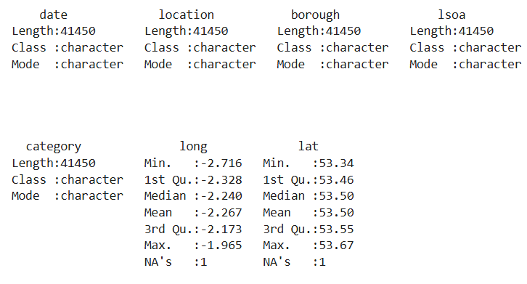
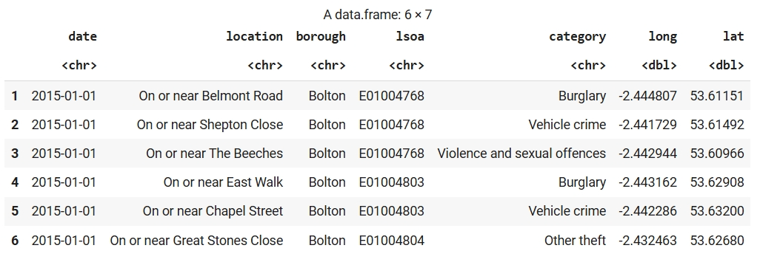
data
preprocessing
Initial Exploration
Data Summary
09

Slide 10
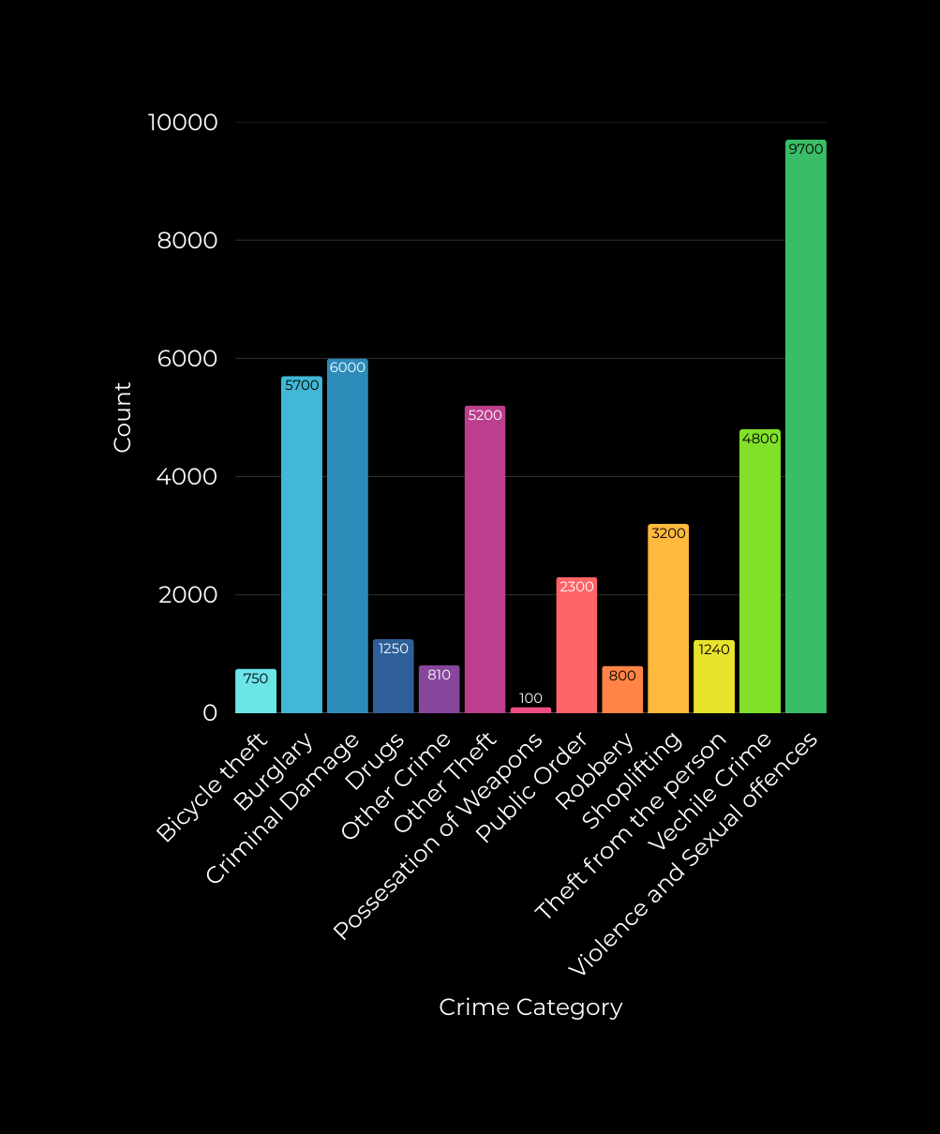
Crime Count by
category
Crime is highest in:
Anti-social behaviour
Vehicle crime
Burglary
Bars show skewed distribution toward top 3 types
10

Slide 11

Top 10 Boroughs with
Highest Crimes
Observed Trends:
top_n(10) identifies most affected boroughs.
Manchester and Bolton are significantly above others.
11

Slide 12


crime trends
over time
Data grouped by date to analyze overall crime volume trends.
Slight increase in crime observed from Jan to Feb.
A dramatic drop (~50%) in March, indicating:
A possible intervention or
Reporting anomaly or
Natural decline
Highlights the importance of tracking temporal trends for better law enforcement planning.
12

Slide 13
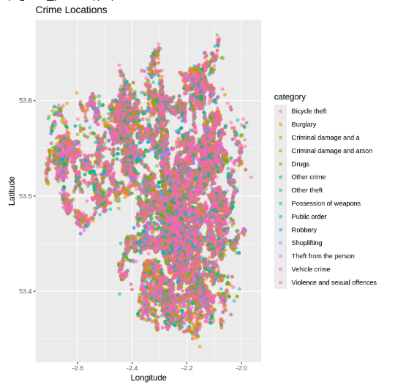
Spatial Crime
distribution
Each point shows the location of an individual crime report
Color-coded by crime category for clear visual grouping
Dense clusters suggest urban hotspots or high-traffic zones
Overlapping points show repeated crimes in same areas
Insightful for deploying CCTV, patrols, or awareness campaigns
13

Slide 14
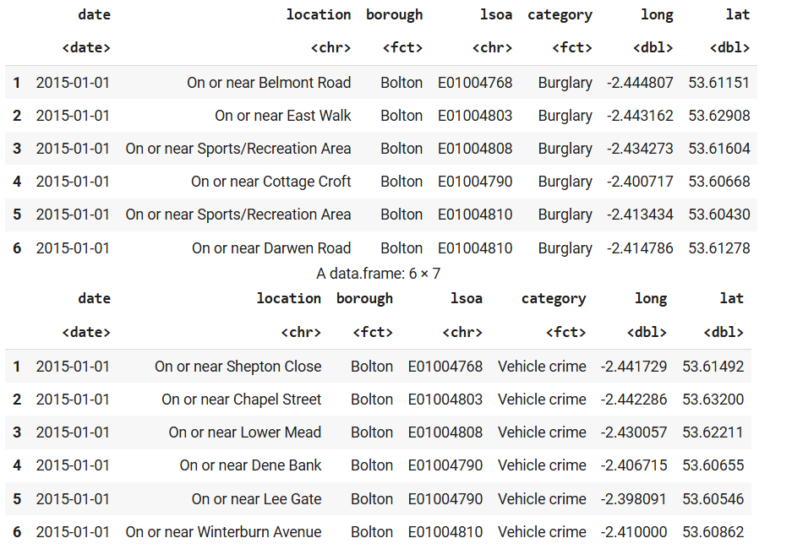
Spatial Crime
distribution
Zooming into Specific Crime Types
Filtered the dataset to focus on Burglary and Vehicle crime.
Both subsets reveal crimes occurring in Bolton borough.
Many incidents happen in similar locations — indicating repeated targeting.
14
WWW.REALLYGREATSITE.COM

Slide 15
location | crime_count
On or near Shopping Area | 1262
On or near Supermarket | 1147
On or near Parking Area | 1141
On or near Petrol Station | 793
On or near Nightclub | 571
On or near Sports/Recreation Area | 377
On or near Further/Higher Educational Building | 212
On or near Pedestrian Subway | 183
On or near Hospital | 155
On or near Piccadilly | 130
CRIME COUNT BY
LOCATION
Crime data grouped by exact location description.
Shopping areas, supermarkets, and parking lots are the top 3 hotspots.
High-crime locations often share traits like high traffic, open access, or poor surveillance.
Nightlife venues (e.g., nightclubs) also show significant numbers.
Data helps prioritize security measures for public zones.
Enables better urban planning and CCTV deployment in high-risk zones.
15

Slide 16

crime trends
in Manchester
Manchester was identified as the borough with the highest crime count overall.
Line chart shows a steadily increasing trend from January to March.
Crime rose by ~15% in just 2 months — from ~4,450 to ~5,100.
Indicates a need for immediate intervention and deeper investigation.
Highlights the importance of tracking borough-level crime over time.
16

Slide 17
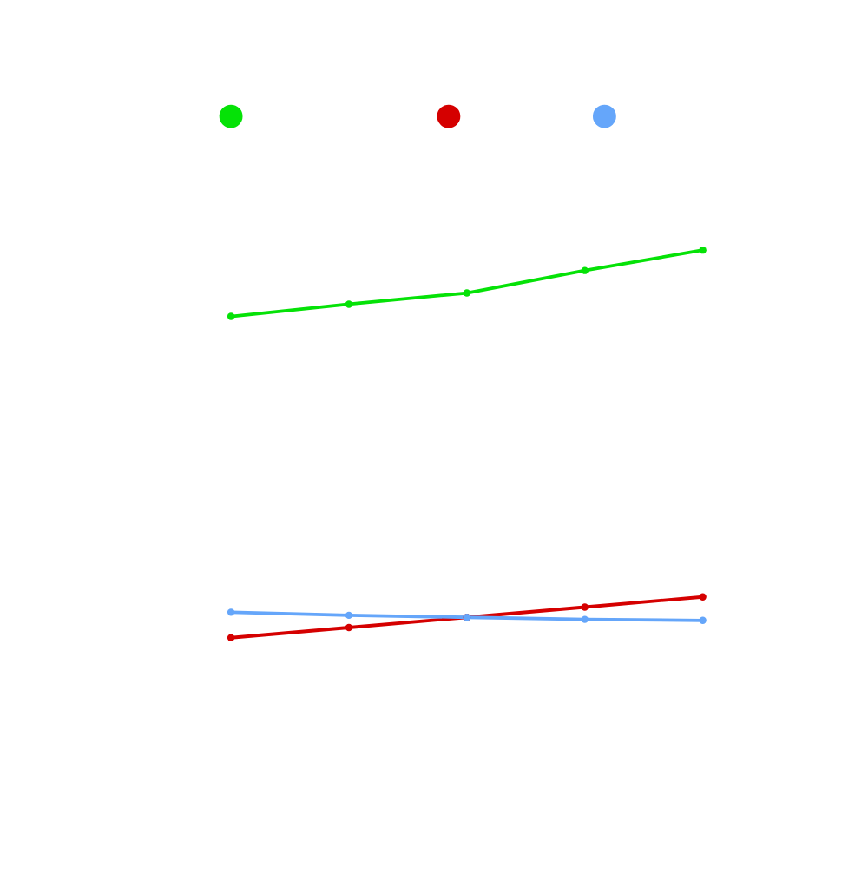
crime trends in
Manchester, Bolton & Wigan
Compared three boroughs with the highest crime volume.
Manchester showed a consistent and sharp increase in crimes.
Bolton displayed a moderate upward trend, indicating gradual rise.
Wigan had a flat or slightly declining trend over the same period.
This comparison helps in resource planning, patrolling allocation, and identifying stable vs. worsening zones.
17

Slide 18
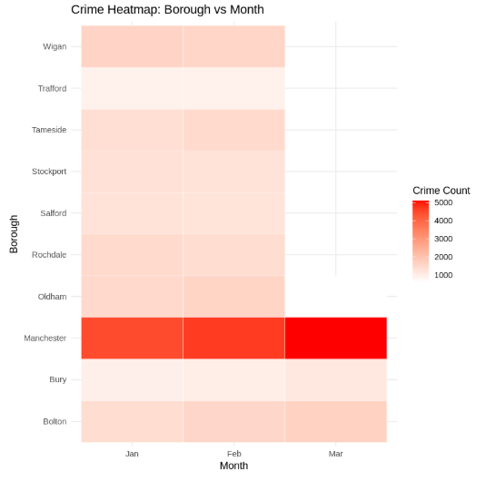
Crime Heatmap
Borough vs Month
A heatmap visually compares crime counts across boroughs and months.
Manchester consistently records the highest number of crimes — peaking in March.
All other boroughs show relatively lower but steady activity.
18

Slide 19
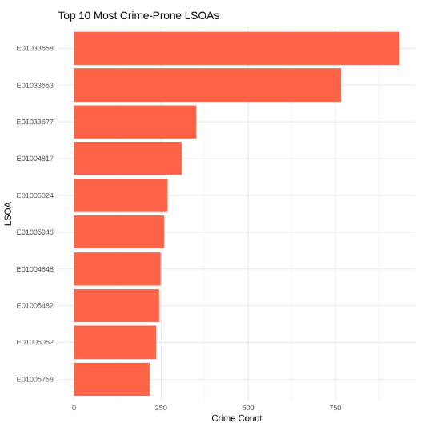
Crime PRONE
LSOA
LSOA = Local neighborhood unit used in UK statistics (1,000–3,000 people).
Crime data grouped by LSOA to identify most affected micro-areas.
LSOAs E01033658 and E01033653 have exceptionally high crime counts.
Some local zones show over 900 incidents, compared to others around 250–300.
Helps law enforcement:
Focus patrols
Install CCTV
Plan outreach at the neighborhood level
19

Slide 20
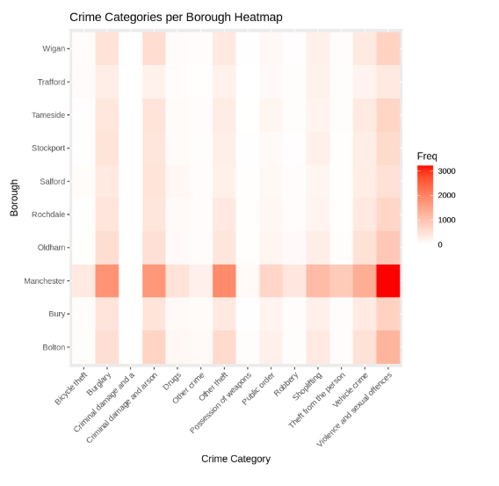
Crime categories
per borough
Manchester leads in nearly all crime categories — especially violent and sexual crimes.
Other boroughs have specific patterns:
For example, Bolton and Bury have relatively higher counts in theft-related crimes.
Heatmap helps identify which crime types are common in which areas.
Allows for targeted interventions, like:
More policing in areas with violent crime
Community programs for burglary-prone zones
20

Slide 21
thank
you!
DATA ANALYSIS IS KEY TO BUSINESS GROWTH AND SUCCESS!
21

